Slide 1

Tree Growth Algorithm (TGA)
This presentation introduces Tree Growth Algorithm (TGA), exploring its principles and applications. We'll analyze the algorithm's structure, complexity, and implications in various fields.
Notes:
1

Slide 2
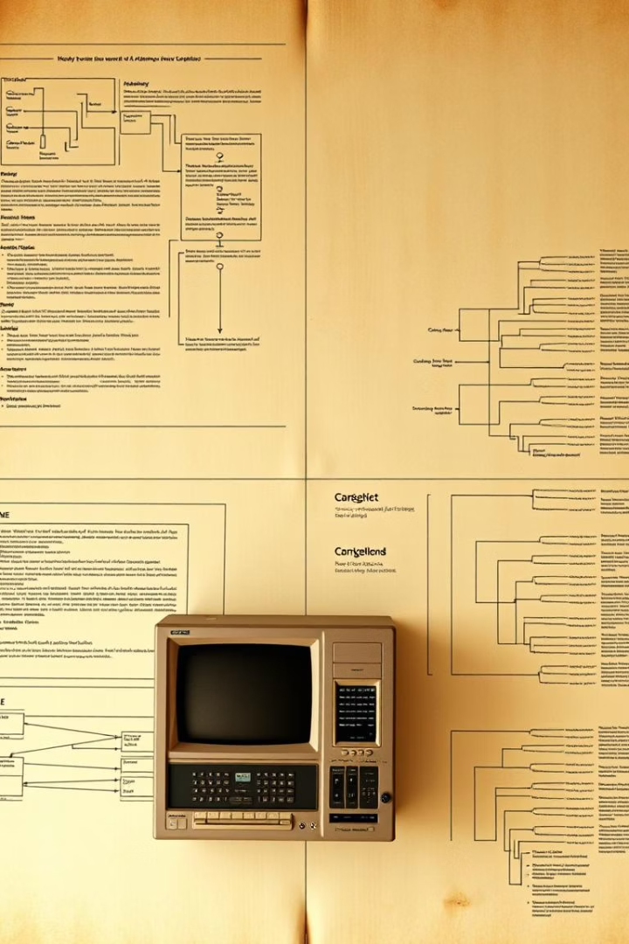

Introduction to Tree Growth Algorithm (TGA)
Origin
Applications
TGA developed to model natural tree growth processes computationally.
Used in biology simulations, computer graphics, and data structures.
Pros & Cons
Advantages include adaptability; drawbacks cover computational cost.
Notes:
2

Slide 3
What is Tree Growth Algorithm (TGA)?
Core Concepts
Process Steps
Example
TGA mimics natural growth by iterative expansion of branches.
Initialization
Start from root, add branches stepwise, halt at rules.
Growth
Termination
Notes:
3

Slide 4
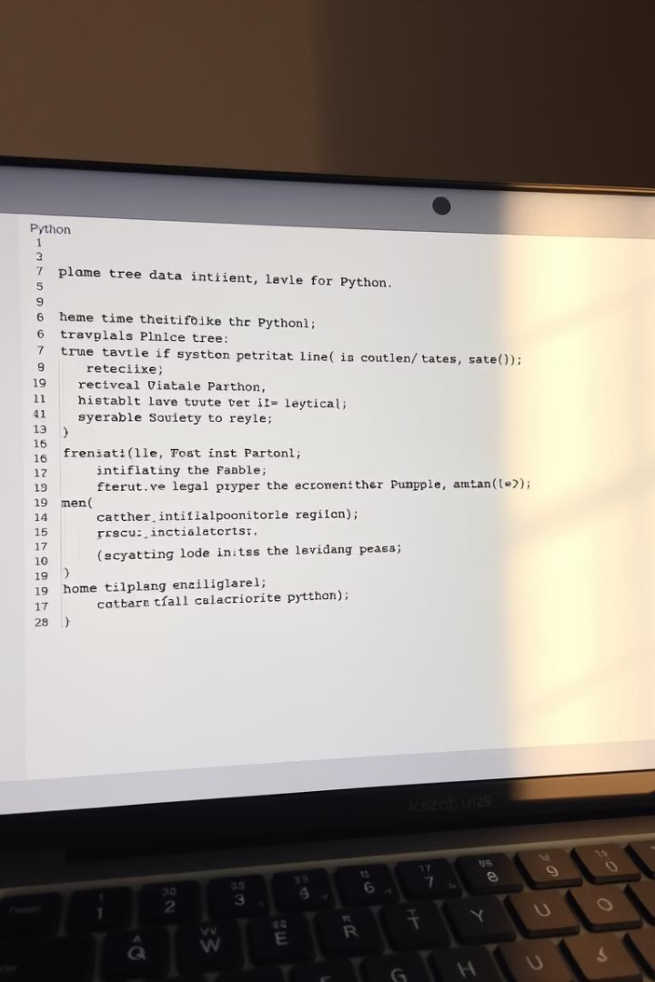
Initialization Phase
Initial Structure
Parameter Setup
Create root node and first branches as the tree base.
Define branch lengths, angles, and growth limits.
Methods
Use randomization or predefined patterns for starting tree.
Notes:
4

Slide 5
Growth Phase
Expansion
Selection Criteria
Environmental Influence
Branches grow by adding nodes based on specific rules.
Choose branches to expand based on growth potential.
Factors like light and space affect branch growth direction.
Notes:
5

Slide 6

Termination Phase
1
Stopping Rules
2
Stable Solution
Growth stops when resources are exhausted or maximum depth reached.
Terminate when tree achieves desired shape or optimization.
3
Refinement
Post-processing to prune or smooth branches for realism.
Notes:
6

Slide 7




Analysis of the TGA Code
Pseudo-code Walkthrough
Step-by-step explanation of logical flow and key loops.
Key Functions
Branch creation, parameter update, and growth evaluation.
Example Scenarios
Different inputs illustrate diverse growth patterns and outputs.
Notes:
7

Slide 8
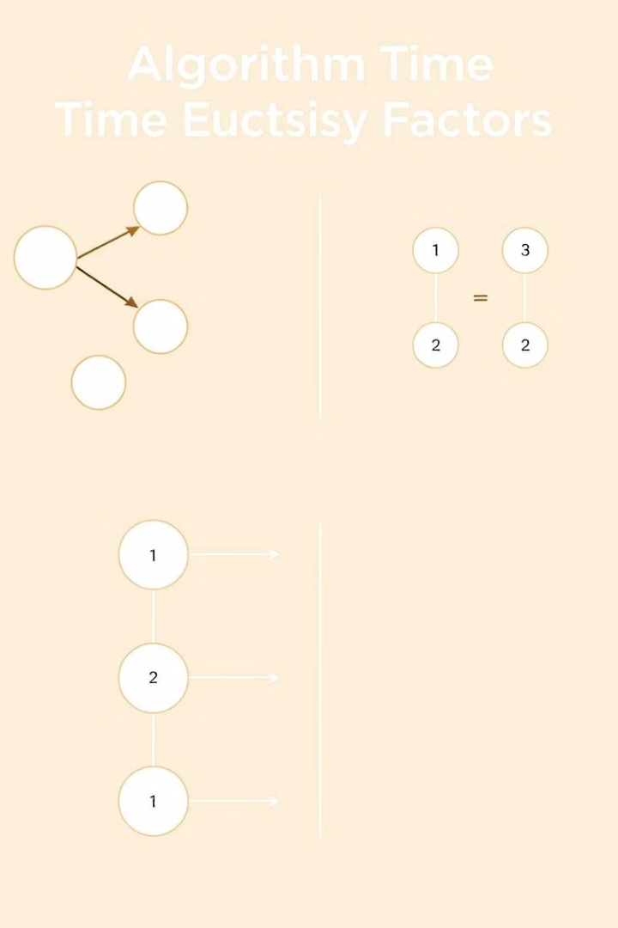
Time Complexity: O(i × n × d)
Iterations (i)
Nodes (n)
Number of growth cycles impacts total runtime linearly.
More nodes increase processing load proportionally.
Depth (d)
Deeper trees multiply complexity by number of levels.
These factors together determine the overall execution time.
Notes:
8

Slide 9
Space Complexity: O(n × d)
Memory Usage
Nodes (n)
Depth (d)
Optimization
Depends on total nodes and how deep the tree extends.
Each node stores data, increasing memory demand.
Greater depth requires additional structure tracking.
Use pruning and efficient data structures to reduce space.
Notes:
9

Slide 10

Conclusion
Summary
Future Research
TGA models natural growth with clear phases and complexity.
Exploration of optimization and adaptation in complex systems.
Applications
Useful in graphics, biology, and hierarchical data processes.
Notes:
10

